Slide 1
Memento Design Pattern
Ali Sukru KARBUZOGLU

Slide 2
Memento Design Pattern
What is the Memento Pattern?
Motivation
Applicability
Structure and Participants
Collaborations
Consequences
Implementation

Slide 3
What is the Memento Pattern?
Without violating encapsulation, capture and externalize an object's internal state so that the object can be restored to this state later.
Frequency of use: low

Slide 4
Motivation
is used to capture the current state of an object and store it in such a manner that it can be restored at a later time.
allows for the internal state of an object to be saved without breaking the rules of encapsulation.
is commonly used to provide an application with "Undo" functionality.

Slide 5
Applicability
Use the memento pattern when;
a snapshot of an object's state must be captured so that it can be restored to that state later
in situations where explicitly passing the state of the object would violate encapsulation

Slide 6
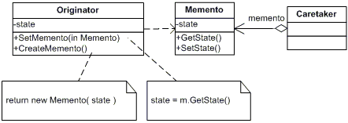
Structure

Slide 7
Participants
Memento
Stores internal state of the Originator object. The state can include any number of state variables.
The Memento must have two interfaces, an interface to the caretaker. This interface must not allow any operations or any access to internal state stored by the memento and thus honors encapsulation. The other interface is to the originator and allows the originator to access any state variables necessary to for the originator to restore previous state.
Originator
Creates a memento object capturing the originators internal state.
Use the memento object to restore its previous state.
Caretaker
Responsible for keeping the memento.
The memento is opaque to the caretaker, and the caretaker must not operate on it.

Slide 8
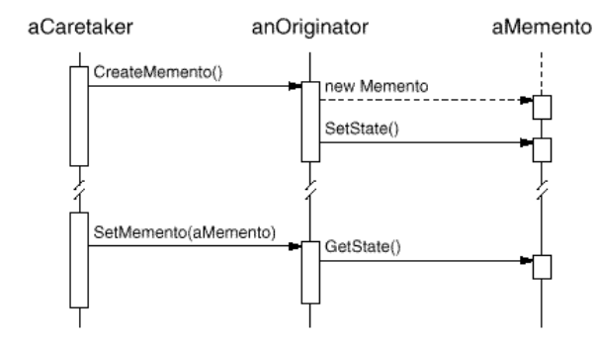
Collaborations
A caretaker requests a memento from an originator, holds it for atime, and passes it back to the originator, as the following interaction diagram illustrates:
Sometimes the caretaker won't pass the memento back to the originator, because the originator might never need to revert to an earlier state.
Mementos are passive. Only the originator that created a memento will assign or retrieve its state.

Slide 9
Consequences
protects encapsulation and avoids exposing originator’s internal state and implementation. Also simplifies originator code such that the originator does not need to keep track of its previous state since this is the responsibility of the CareTaker.
can be expensive depending on the amount of state information that has to be stored inside the memento object. In addition the caretaker must contain additional logic to be able to manage mementos.

Slide 10
References
Elements of Reusable Object-Oriented Software
http://www.blackwasp.co.uk/Memento.aspx
http://www.oodesign.com/memento-pattern.html
http://www.dofactory.com/Patterns/PatternMemento.aspx#intent
http://en.wikipedia.org/wiki/Memento_pattern
http://www.csharpnedir.net/dotnettv/watch/?id=160&title=Design%20Patterns%20:%20Memento

